Slide 1

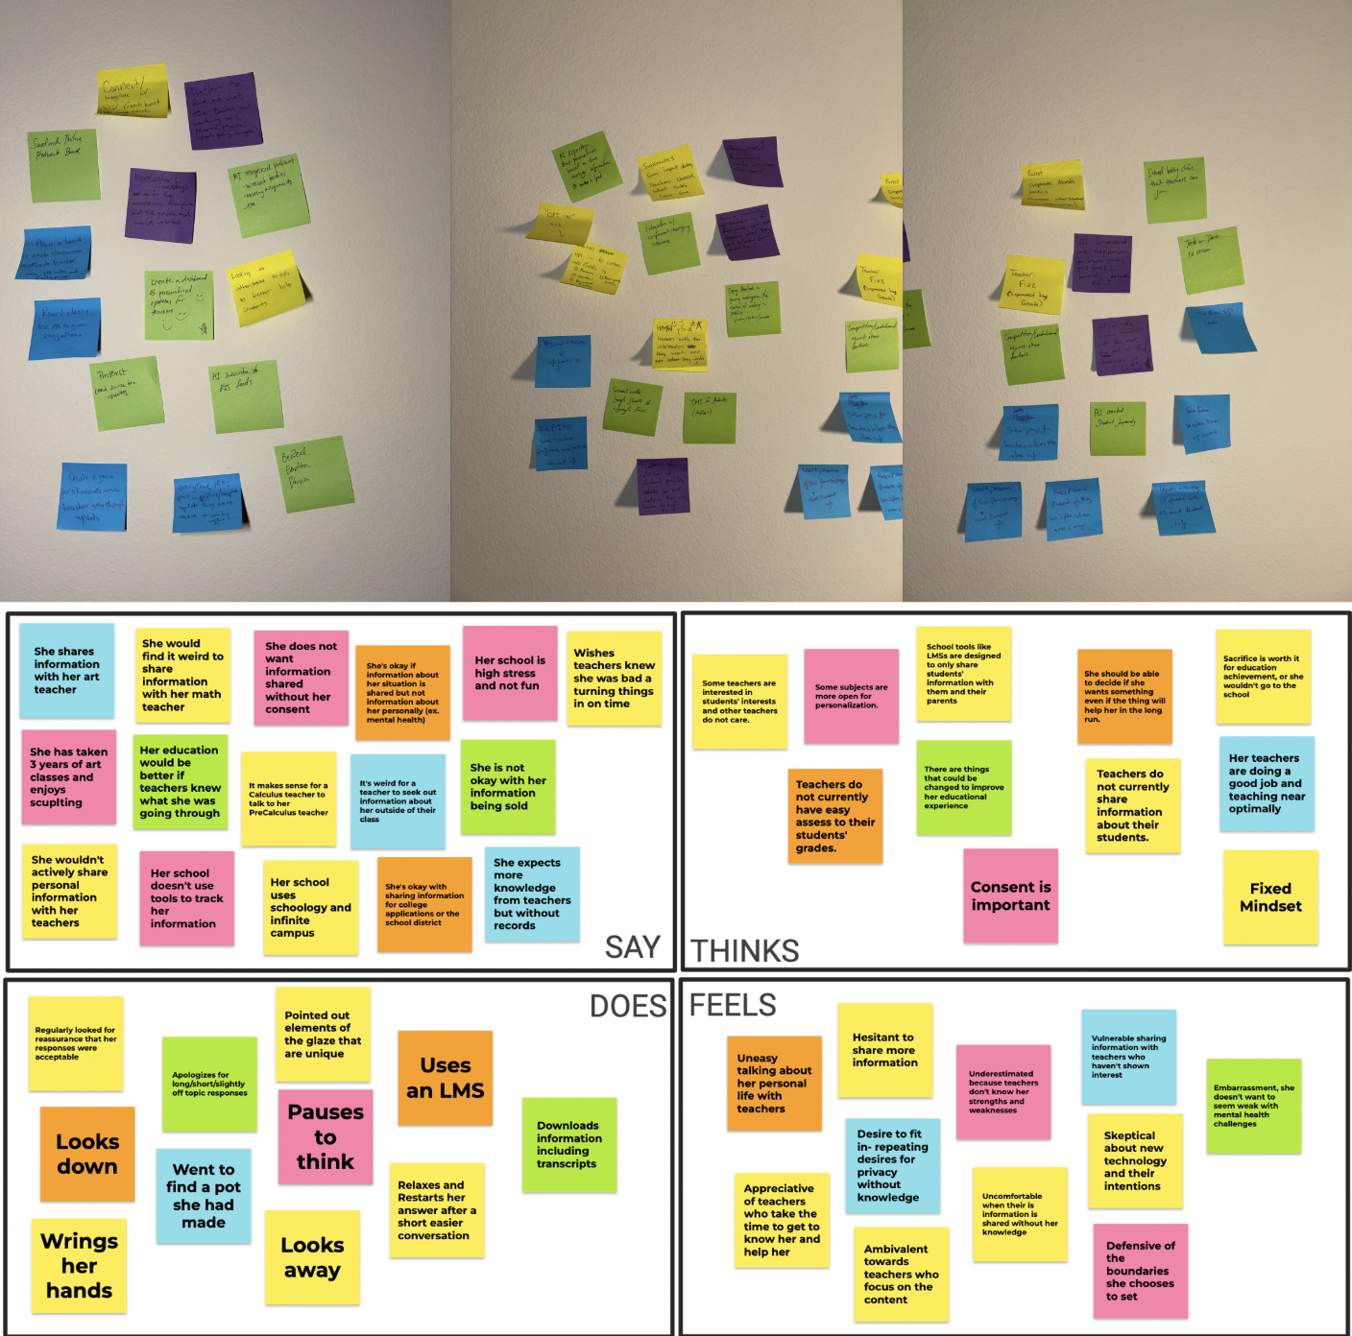

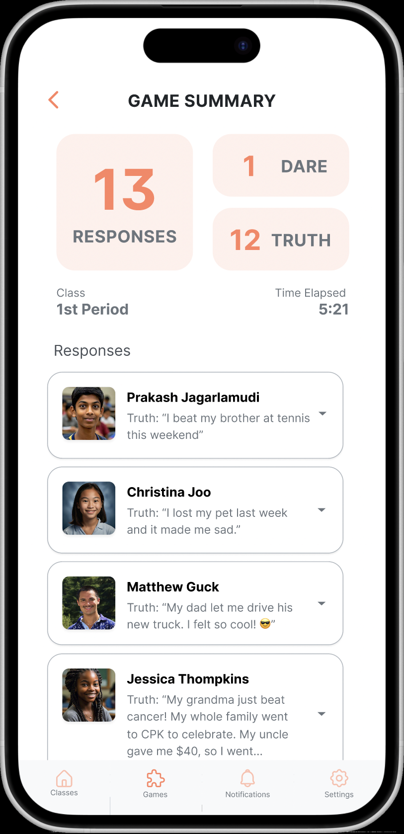
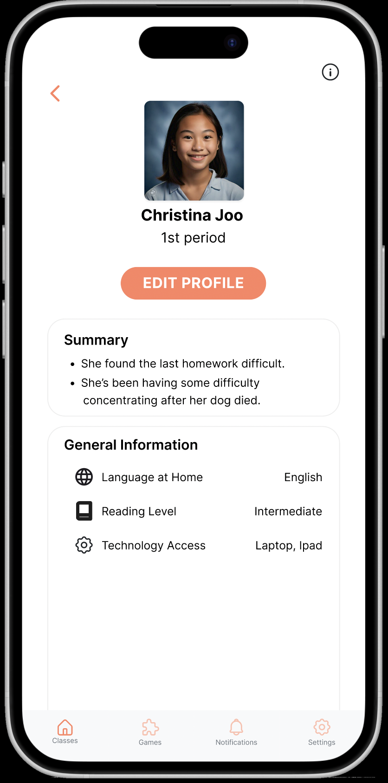
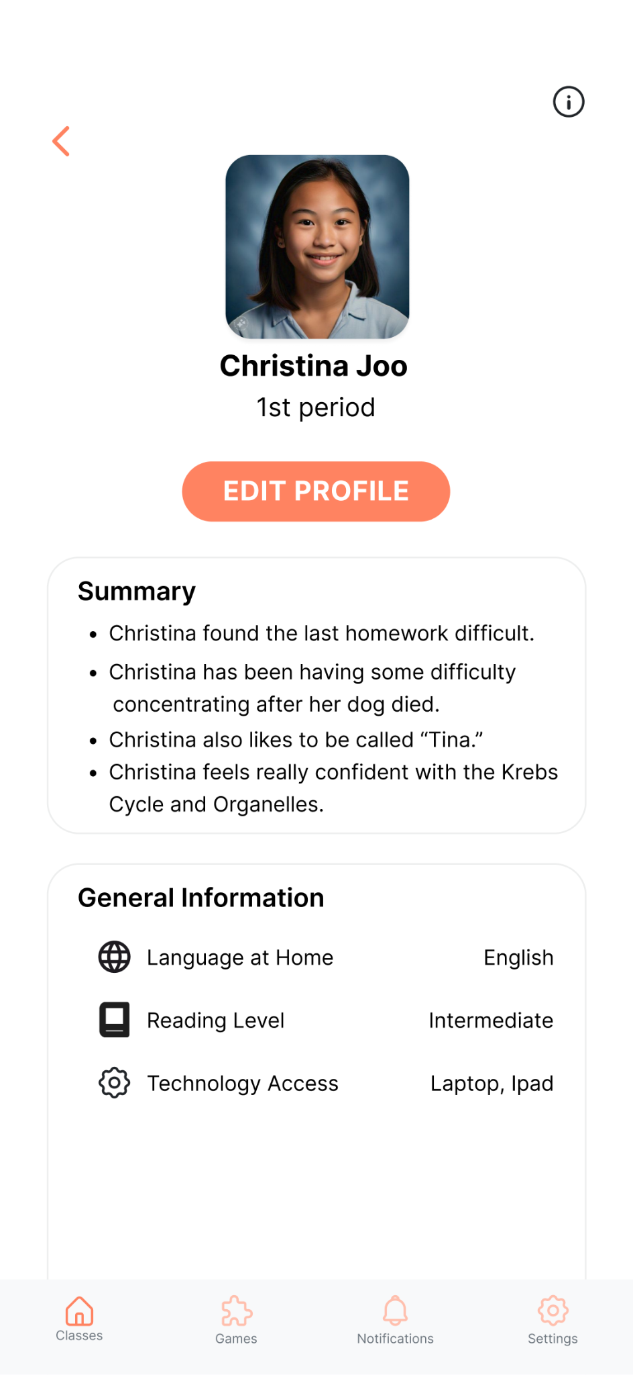
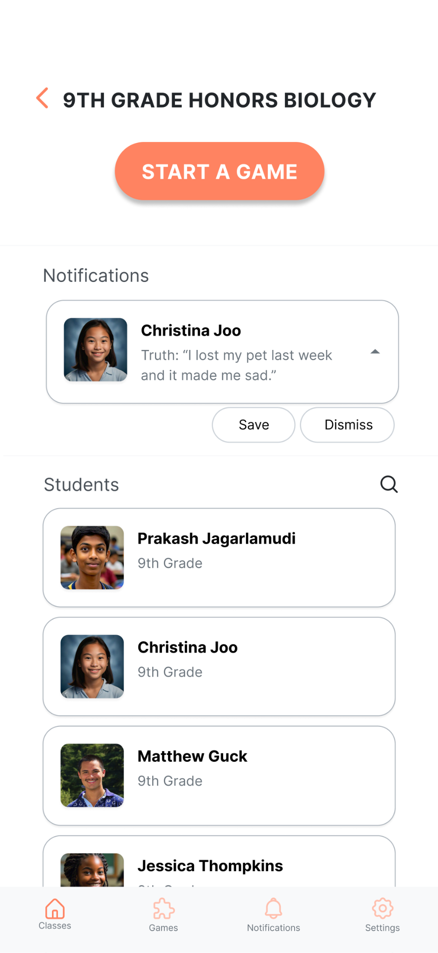
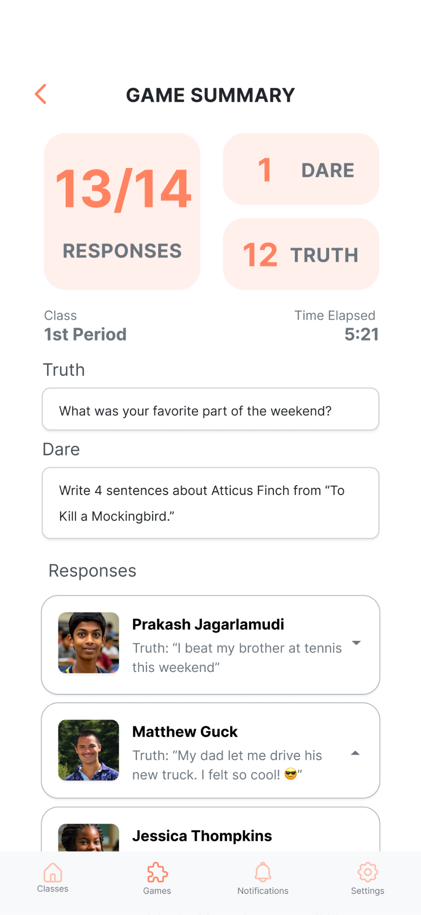
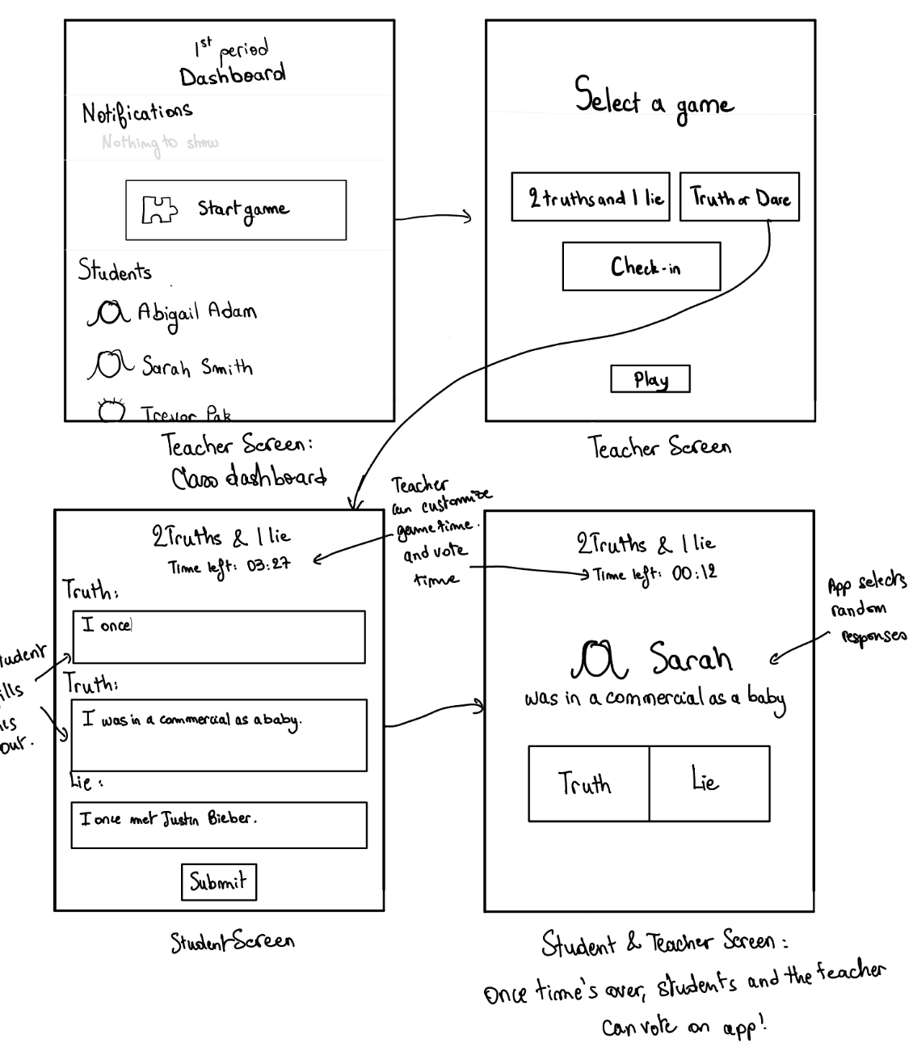
Problem
Teachers Struggle to Develop Meaningful Connections with Students
Design Process
Needfinding
Solution
EKG uses Truth/Dare, 2 Truths/Lie, and AI generated improv games to collect information about students.
Learn about your students through engaging, in-class games!
Insight Testing
Lo-Fi Prototype
Play games to learn more about your students
Get helpful insights
about your students
Save and share alerts
with co-teachers
Designed and Developed by: Baihan Z, Jessica Y, Oumnia C, Matthew G CS 147 Autumn 2024 Project URL: https://hci.stanford.edu/courses/cs147/2024/au/projects/AI-In-Classroom/EKG/

Slide 2
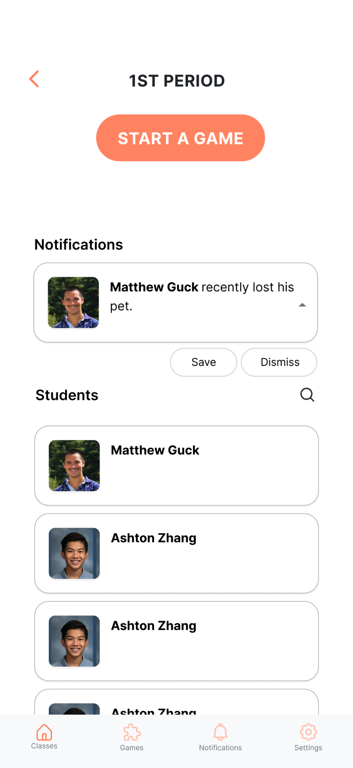
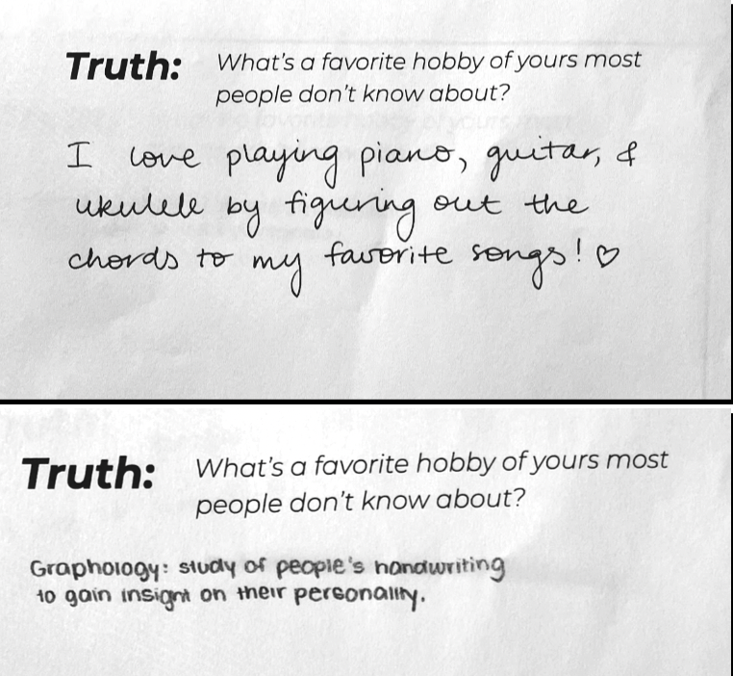
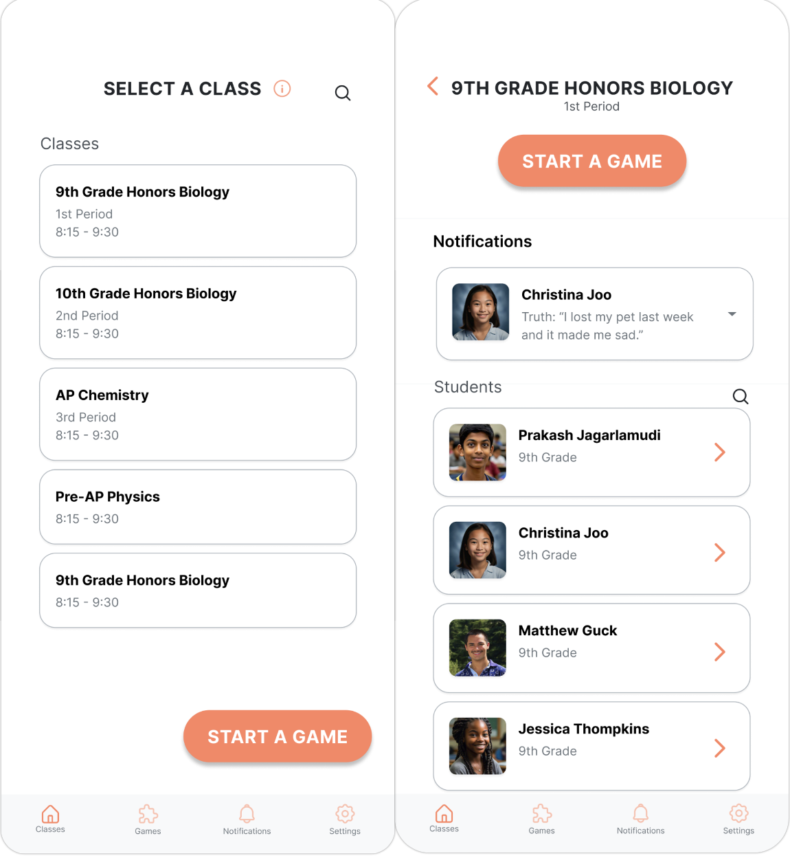
Design Process
Learn about your students through engaging, in-class games!
Needfinding
Testing
Low-Fi Prototype
Play Truth/Dare To Collect Student Info
Read About Your Students
Get Alerts about Students from Other Teachers
Problem
Teachers Struggle to Develop Meaningful Connections with Students
Solution
EKG uses Truth/Dare, 2 Truths/Lie, and AI generated improv games to collect information about students.
High-Fi Prototype
Baihan Z, Jessica Y, Oumnia C, Matthew G || CS 147 Autumn 2024 || https://hci.stanford.edu/courses/cs147/2024/au/projects/AI-In-Classroom/EKG/

Slide 3
Problem
Teachers Struggle to Develop Meaningful Connections with Students
Design Process
Needfinding
Learn about your students through engaging, in-class games!
Solution
EKG uses Truth/Dare, 2 Truths/Lie, and AI generated improv games to collect information about students.
Insight Testing
Lo-Fi Prototype
Play games to learn more about your students
Get helpful insights
about your students
Save and share alerts
with co-teachers
Designed and Developed by: Baihan Z, Jessica Y, Oumnia C, Matthew G || CS 147 Autumn 2024 || Project URL: https://hci.stanford.edu/courses/cs147/2024/au/projects/AI-In-Classroom/EKG/

Slide 4
Design Process
Learn about your students through engaging, in-class games!
Needfinding
Testing
Low-Fi Prototype
Play Truth/Dare To Collect Student Info
Read About Your Students
Get Alerts about Students from Other Teachers
Problem
Teachers Struggle to Develop Meaningful Connections with Students
Solution
EKG uses Truth/Dare, 2 Truths/Lie, and AI generated improv games to collect information about students.
High-Fi Prototype
Baihan Z, Jessica Y, Oumnia C, Matthew G || CS 147 Autumn 2024 || https://hci.stanford.edu/courses/cs147/2024/au/projects/AI-In-Classroom/EKG/

Slide 5
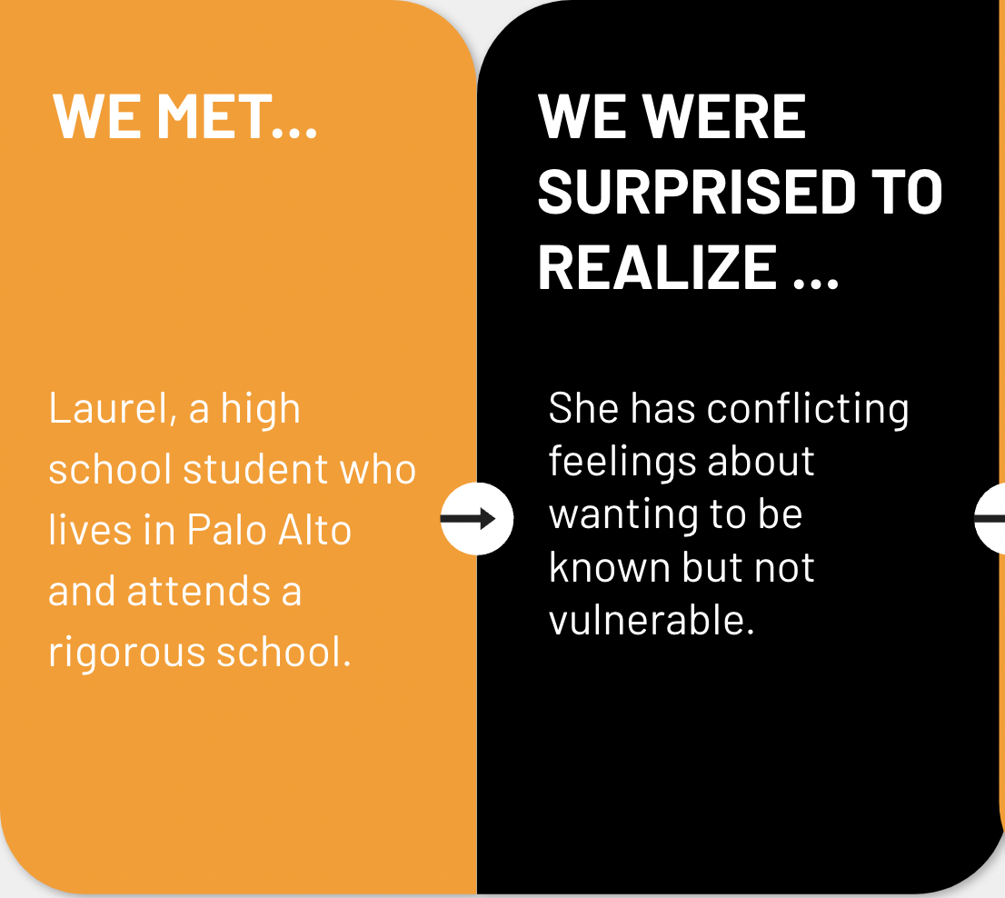
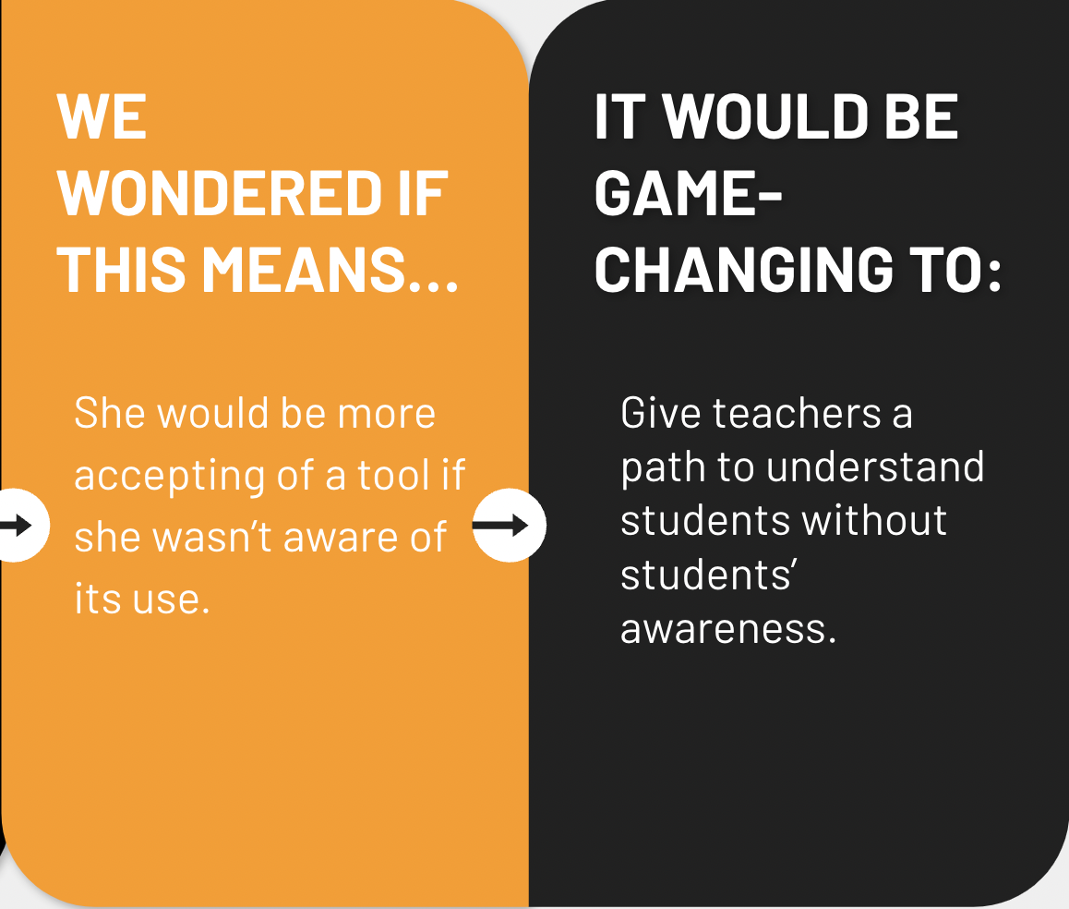
Design Process
Learn about your students through engaging, in-class games!
Needfinding
Testing
Low-Fi Prototype
Play Truth/Dare To Collect Student Info
Read About Your Students
Get Alerts about Students from Other Teachers
Problem
Teachers Struggle to Develop Meaningful Connections with Students
Solution
EKG uses Truth/Dare, 2 Truths/Lie, and AI generated improv games to collect information about students.
High-Fi Prototype
Baihan Z, Jessica Y, Oumnia C, Matthew G || CS 147 Autumn 2024 || https://hci.stanford.edu/courses/cs147/2024/au/projects/AI-In-Classroom/EKG/

Slide 6
Design Process
Needfinding
Learn about your students through engaging, in-class games!
Testing
Low-Fi Prototype
Play Truth/Dare To Collect Student Info
Read About Your Students
Get Alerts about Students from Other Teachers
Problem
Teachers Struggle to Develop Meaningful Connections with Students
Solution
EKG uses Truth/Dare, 2 Truths/Lie, and AI generated improv games to collect information about students.
High-Fi Prototype
Baihan Z, Jessica Y, Oumnia C, Matthew G || CS 147 Autumn 2024 || https://hci.stanford.edu/courses/cs147/2024/au/projects/AI-In-Classroom/EKG/

Slide 8
EKG

Slide 9
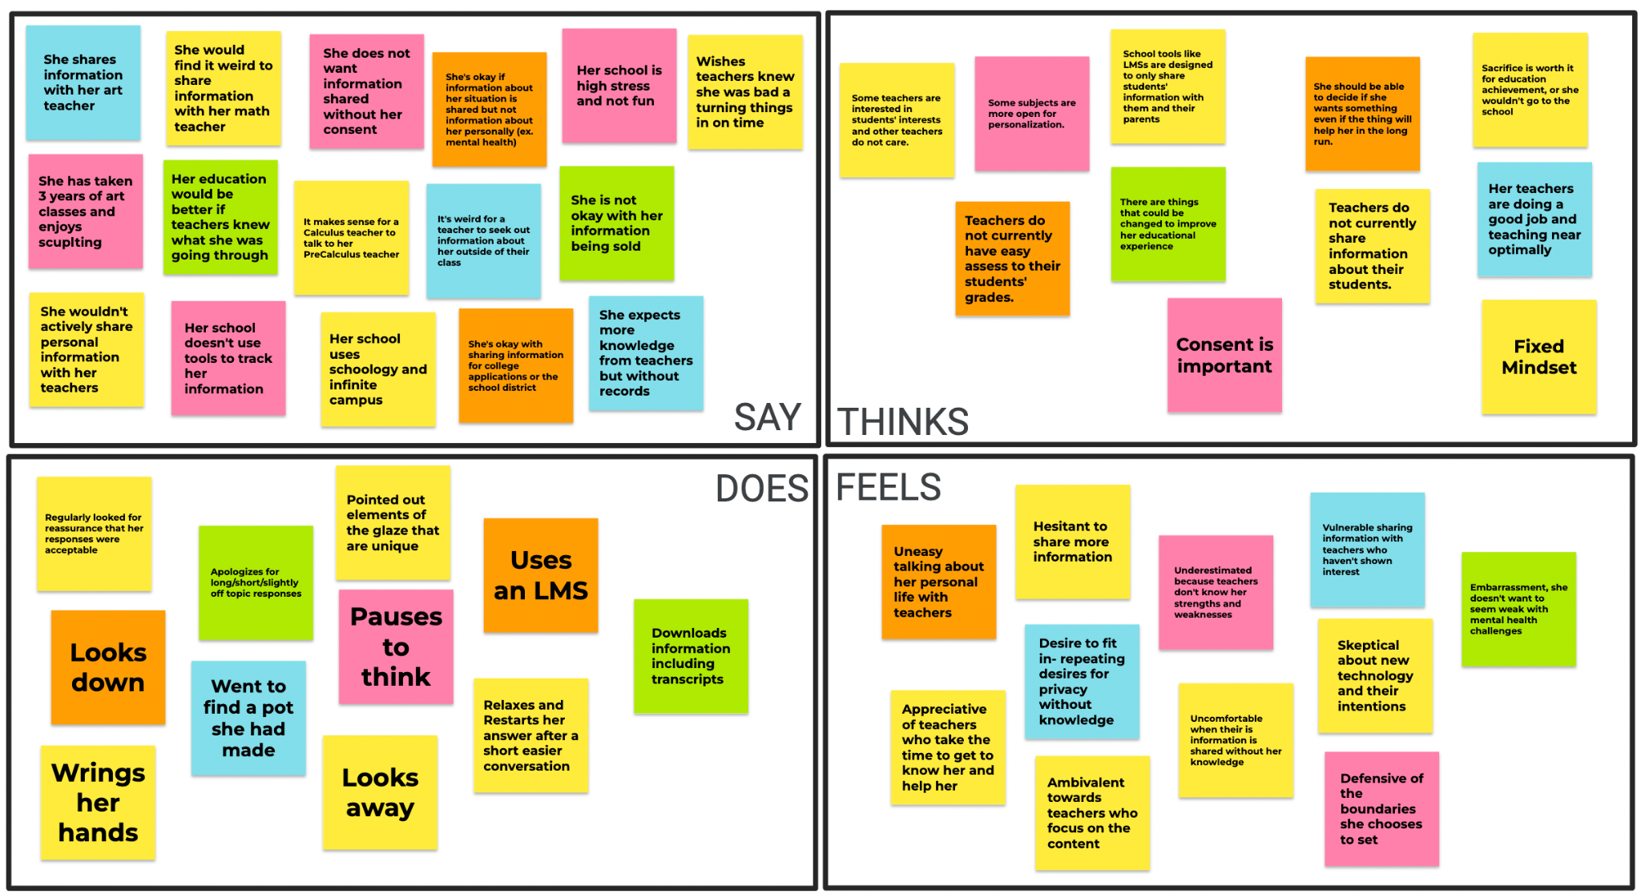

Slide 10

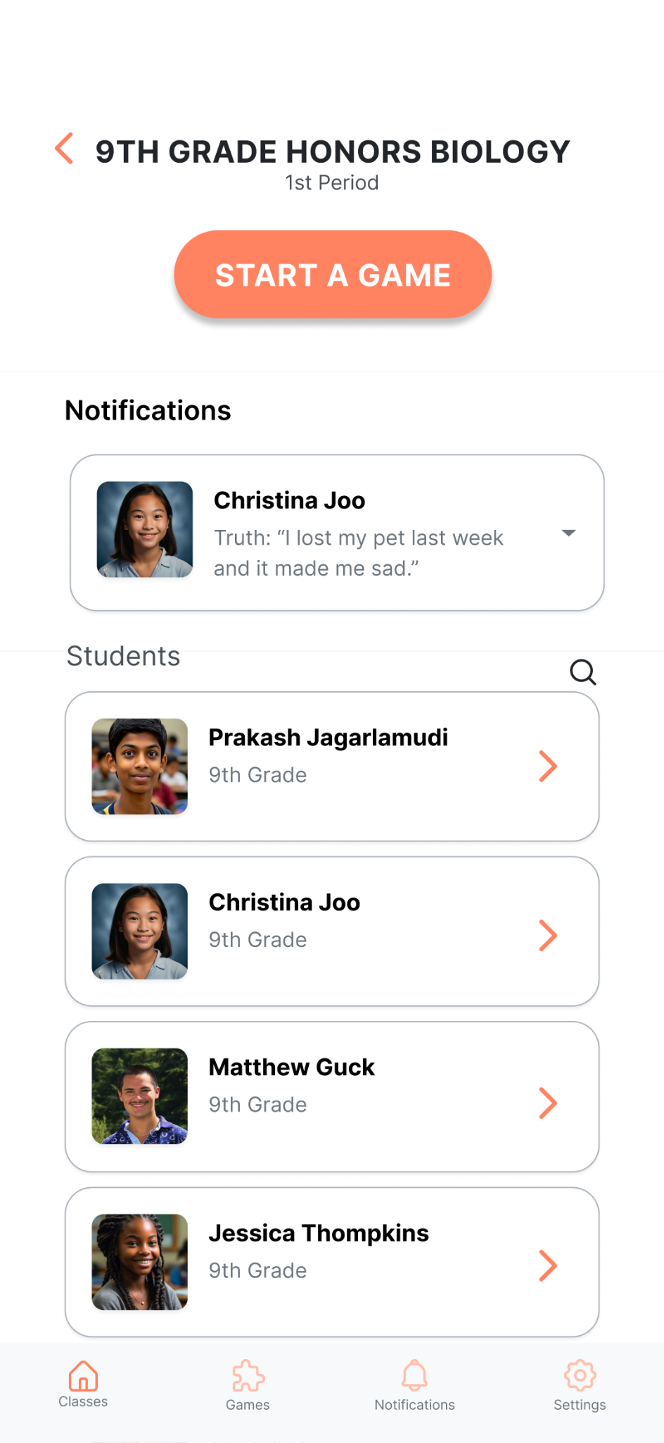

Slide 11
